Slide 1

DEPARTMENT OF ARTIFICIAL INTELLIGENCE AND DATA SCIENCE ACADEMIC YEAR 2025 - 2026 SEMESTER III ARTIFICIAL INTELLIGENCE LABORATORY MINI PROJECT REVIEW <TITLE OF THE PROJECT>
REGISTER NUMBER
NAME | VishnuVardhan A
YEAR | II
SECTION | F
FACULTY IN-CHARGE | Mrs. M. Divya

Slide 2
PROBLEM STATEMENT
The project uses Artificial Intelligence (AI), specifically Bayesian inference, to enhance medical diagnosis by estimating disease probabilities based on symptoms. AI helps analyze medical data to support quicker and more accurate decisions, crucial for effective treatment.
Problem: Traditional diagnosis methods often struggle with uncertainty from ambiguous symptoms and test results. This system uses Bayesian theorem to update disease likelihoods as new symptom information is received, providing a clearer probabilistic diagnosis.
This project builds a tool that takes user symptoms, applies Bayesian calculations on a disease database, and outputs the top probable diseases along with treatment and disease characteristics.
Expected outcome: An interpretable, data-driven diagnosis system that ranks diseases by probability, aiding healthcare providers in making informed decisions. It embodies AI’s strength in handling uncertainty and improving diagnosis accuracy in clinical practice.
This concise system exemplifies practical AI application in medicine, transforming symptom input into actionable diagnostic probabilities through Bayesian reasoning.

Slide 3
THEORETICAL BACKGROUND
Theoretical Background and Algorithm: The project employs Bayes’ Theorem, a fundamental principle in probability theory that updates the probability of a hypothesis (disease) given new evidence (symptoms). Bayes' Theorem calculates conditional probabilities by combining prior probabilities (initial disease likelihood) and likelihoods (probability of symptoms given the disease). This process models diagnostic reasoning as a probabilistic update reflecting how new symptom data increases or decreases the likelihood of diseases.
Literature Survey and Algorithms: Bayesian inference is widely recognized for medical diagnosis due to its interpretability and mathematical rigor. Alternative algorithms include machine learning classifiers like decision trees, neural networks, and support vector machines; however, they often act as "black boxes" with less transparent reasoning. Bayesian approaches uniquely align with clinical diagnostic thinking by explicitly handling uncertainty and sequential evidence updating.
Justification for Algorithm Choice: Bayesian theorem is chosen for its simplicity, strong theoretical foundation, and ability to incorporate prior medical knowledge with symptom data. It facilitates clear probabilistic outputs for diagnosis, which clinicians can interpret and trust.
Algorithm Explanation with Example: Suppose a disease has a 1% prior probability. A symptom commonly appears in 80% of cases with the disease. Using Bayes’ Theorem, the posterior probability of the disease given the symptom is computed by multiplying the prior and likelihood, normalized over all possible outcomes. This yields a refined probability estimate that better informs diagnosis compared to binary symptom presence.

Slide 4
IMPLEMENTATION AND CODE
Link to code in Git-hub Repository
List | Git-hub Repository Links
Implementation of Code Link | https://github.com/VishnuVardhanAtech/Aiminiprj
Word Document Report Link | https://github.com/VishnuVardhanAtech/Aiminiprj
PPT Link | https://github.com/VishnuVardhanAtech/Aiminiprj

Slide 5
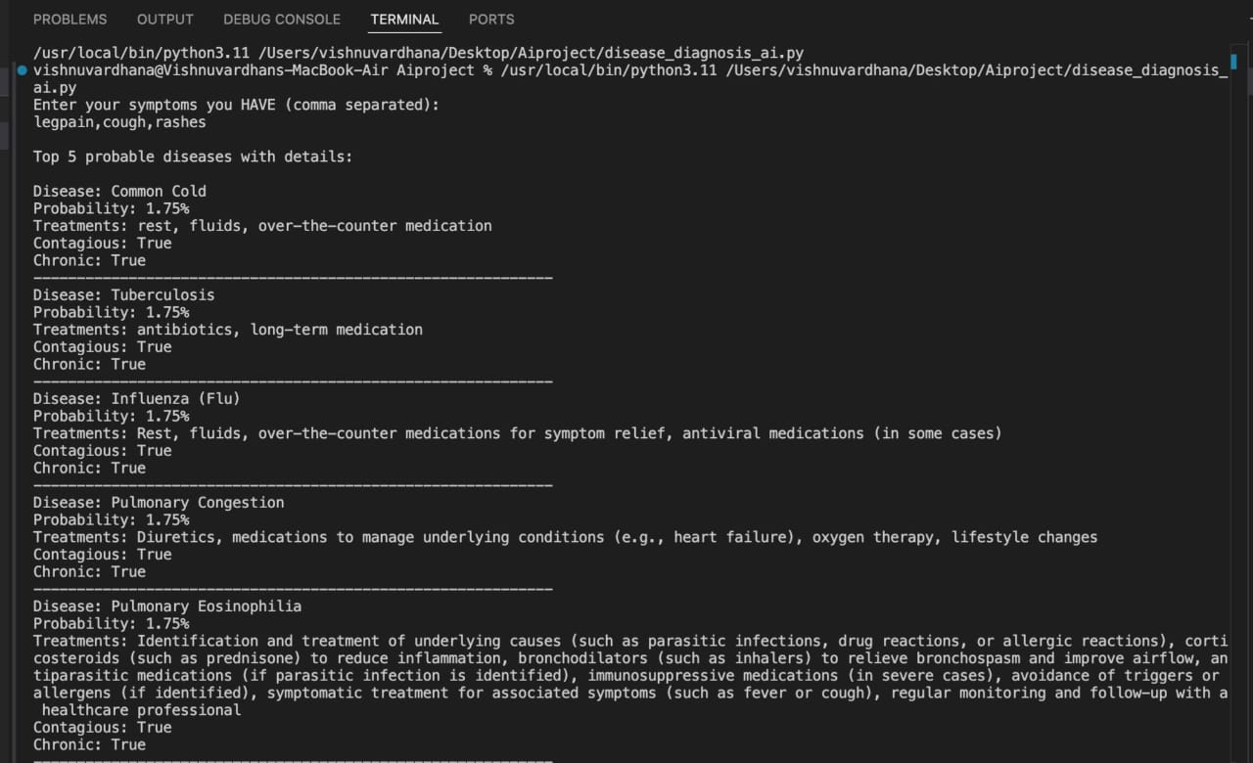
OUTPUT AND RESULTS

Slide 6
OUTPUT AND RESULTS
Output Explanation: The output screen displays a list of the top five probable diseases based on user-entered symptoms, each with an associated probability percentage. Alongside each disease, treatment recommendations, and details on contagiousness and chronicity are shown. This presentation allows users to quickly grasp the likelihood of each disease and relevant medical guidance. The interface is designed to be clear and user-friendly for both patients and healthcare providers.
Results and Future Enhancements: The system effectively provides a probabilistic disease diagnosis that improves decision-making by handling uncertainty in symptoms. It aids early detection and personalized care through interpretable Bayesian inference. Future enhancements could include integrating a larger, dynamic disease database, incorporating real-time symptom updates, improving symptom likelihood estimations with machine learning, and providing a mobile application interface for broader accessibility. Implementing multi-modal data inputs like imaging or lab results could also enhance accuracy and usability.

Slide 7
REFERENCES
Bayesian Biostatistics and Diagnostic Medicine Author: Lyle D. Broemeling Publisher: CRC Press, 2007 Overview: Introduction to Bayesian methods in diagnostic medicine, including applications, models, and case studies.
Bayesian Disease Mapping: Hierarchical Modeling in Spatial Epidemiology (Third Edition) Author: Andrew B. Lawson Publisher: Chapman & Hall/CRC Interdisciplinary Statistics, 2021 Overview: Comprehensive coverage of Bayesian hierarchical models applied to disease mapping and epidemiology.
Medical Diagnosis System: Based on Bayesian Decision Theory Author: Unknown (Look for similar titled works) Overview: Focus on applying Bayesian decision theory to improve clinical diagnostic accuracy.
Bayesian Data Analysis Authors: Andrew Gelman, John B. Carlin, Hal S. Stern, David B. Dunson, Aki Vehtari, Donald B. Rubin Publisher: Chapman & Hall/CRC, 2013 Overview: Fundamental text on Bayesian inference methods, useful for understanding probabilistic modeling in medical diagnostics.
Bayesian Networks: With Examples in R Authors: Marco Scutari, Jean-Baptiste Denis Publisher: CRC Press, 2021 Overview: Practical guide to Bayesian networks, which are more advanced probabilistic graphical models relevant to disease diagnosis.

